Slide 1
Project : CSE 3200 Project Name : OCR Ultimate
Supervised By:
Mahtab Ahmed
Lecturer, Department of Computer Science and Engineering , Khulna University of Engineering & Technology , Khulna-9203, Bangladesh .
Developed By:
Tanmoy Tapos Datta
Roll : 1307006
&
Arunima Mandal
Roll : 1307018

Slide 2
Contents
Introduction
Why use OCR Ultimate
About our project
Features of the app
Workflow
How the app works
Application
Limitations
Future plans

Slide 3
Introduction to OCR Ultimate
An android based mobile application.
An android application which can show both real time and offline conversion of any handwritten text or printed text. It needs no internet connection.
Basically we are using Google Vision API, for detcting text real time and OpenCV, an open source image processing library before detecting text via Tesseract. It has improved the detecting quality of Google Tesseract.

Slide 4
Why use OCR Ultimate?

Slide 5
There are many cases such as converting an image into a machine readable text where the need of an OCR is felt. Though OCR machine is very expensive and takes only scanned photos which further add to the cost, Google Drive gives you an option to do it for free. But what if you don’t have a data connection all the time?
Yes, OCR apps are there in the market but they do need some improvements. Either they are not accurate or require a data connection so that you can upload your images to their servers and they’ll convert it into a document. So today we have an app that is devoid of all these defects to some extent.

Slide 6
About our project

Slide 7
Used libraries for project
Google Vision API ( An API for Machine Learning by Google)
Google Tesseract (An optical character recognization library)
OpenCV (An image processing library)

Slide 8
What Is Google API
Google Vision API is the product by Google , releasen on December,2015.
It uses Machine Learning for Handwritten text detection by matrix multiplication.
It detects text such as- once detected, the recognizer then determines the actual text in each block and segments it into lines and words. The Text API detects text in Latin based languages (French, German, English, etc.), in real-time, on device.
The Text Recognizer segments text into blocks, lines, and words. Roughly speaking:
a Block is a contiguous set of text lines, such as a paragraph or column,
a Line is a contiguous set of words on the same vertical axis, and
a Word is a contiguous set of alphanumeric characters on the same vertical axis.

Slide 9
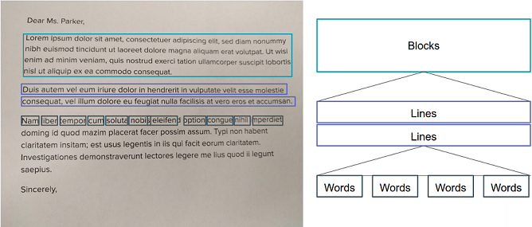
Google Vision API analyzing text

Slide 10
What is Google Tesseract?
Google Tesseract is one of top three OCR engines
It is capable of detecting more than 60 languages
It is considered one of the most accurate open source OCR engines currently available
Combining with the Leptonica image processing library it can read a wide variety of image formats and convert them to text.

Slide 11
What is OpenCV?
OpenCV is an open source computer vision and machine learning software library
The library has more than 2500 optimized algorithms
These algorithms can be used to detect and recognize faces, identify objects, classify human actions in videos and other image processing works
It can process image in real time using these algorithms

Slide 12
Features of the app
User friendly graphical interface.
Can get real time text extraction from any document.
Can get text extraction from an image.
One can choose image from the gallery. One should choose clear images because the app doesn’t work for blur images.
Can get text from any hand-written document or printed document.
Before capturing an image, “Auto focus” switch button is there for getting clear images.
If there is situation like one can’t get enough light to capture clear image, then before capturing an image, “Use flash” switch button is there for getting clear images.
After extracting the text, one can copy or edit it to any clipboard or document within the phone.
The app needs no internet connection.

Slide 13
Workflow of OCR Ultimate

Slide 14
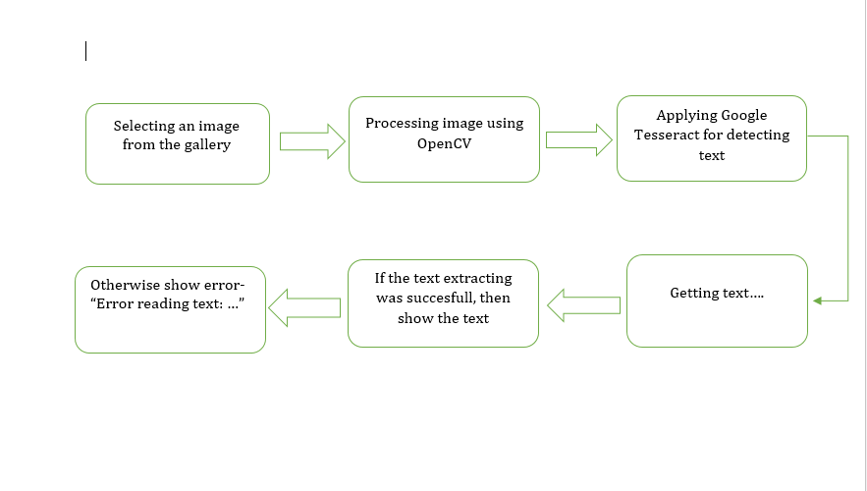
Fig : Workflow of OCR Ultimate

Slide 15
How the app works?

Slide 16
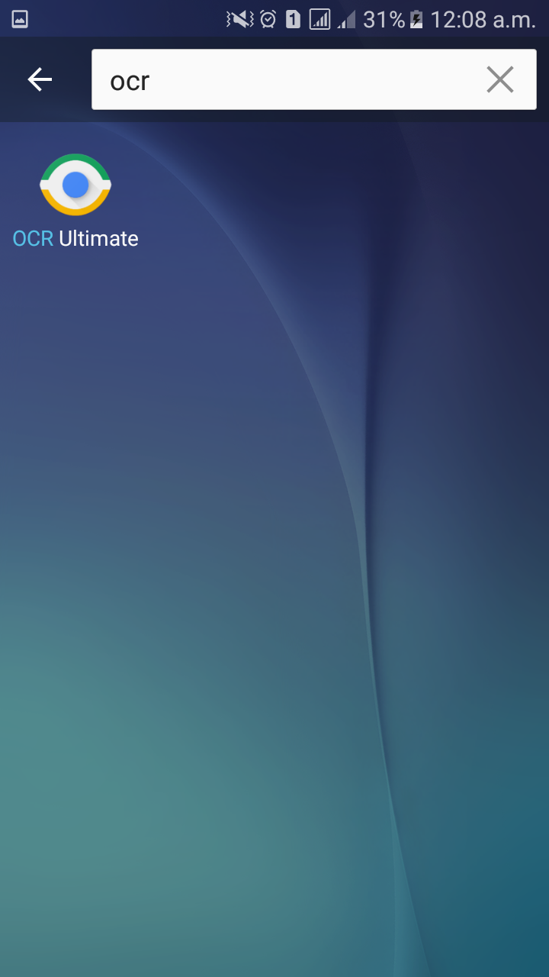
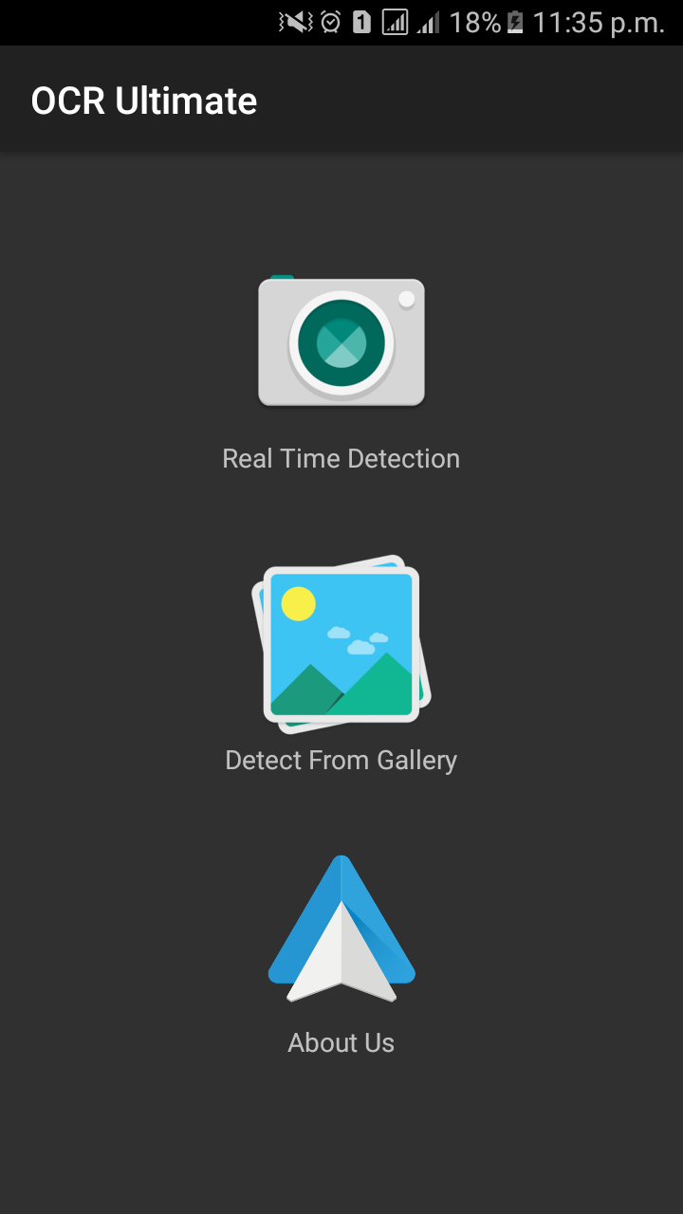
Start Page

Slide 17
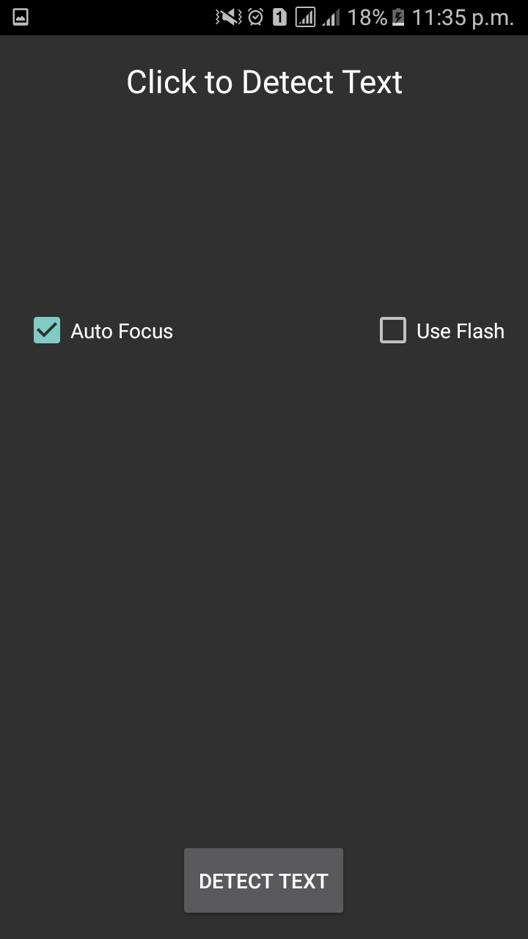
Real Time “Detect text” button

Slide 18
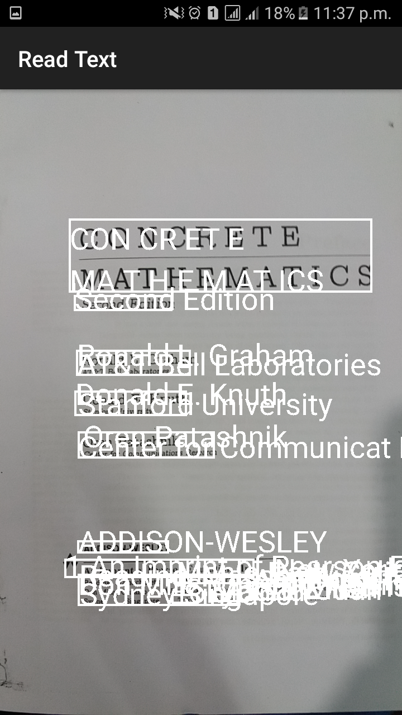
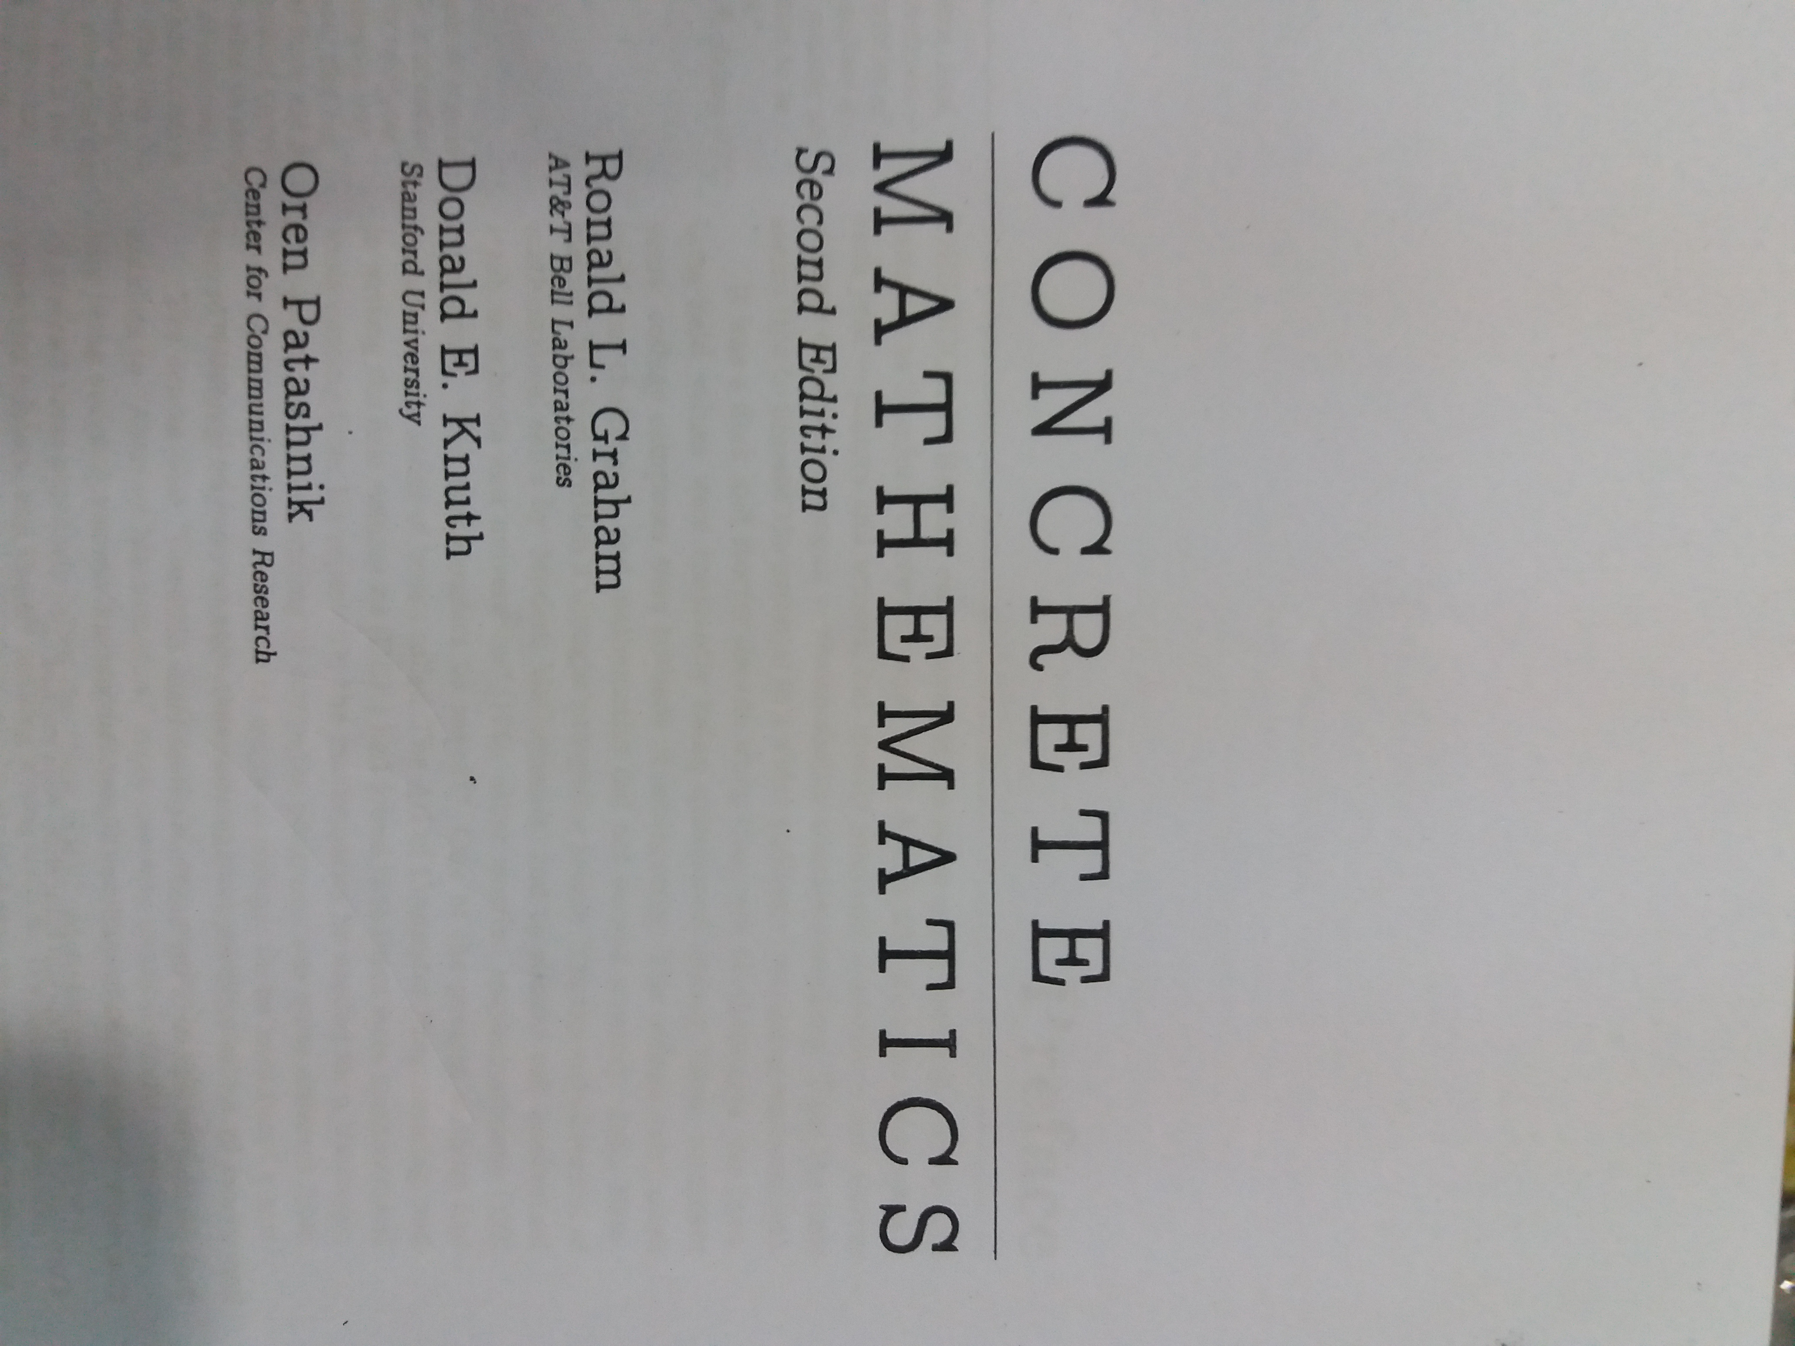
On clicking “Detect text” button & switching ON the “Auto focus”

Slide 19
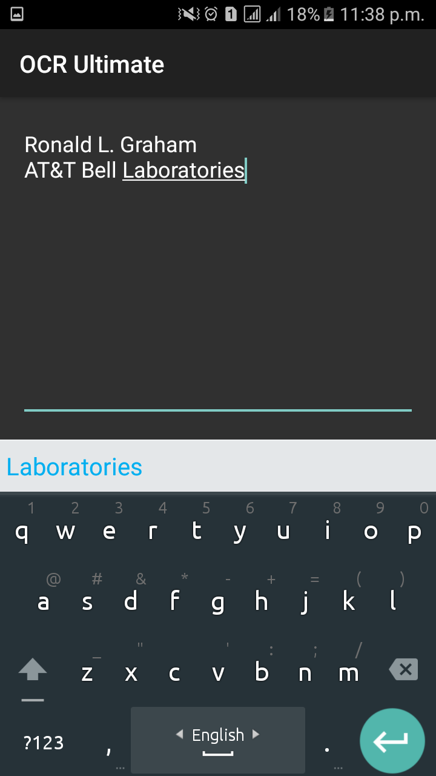
Text detection

Slide 20
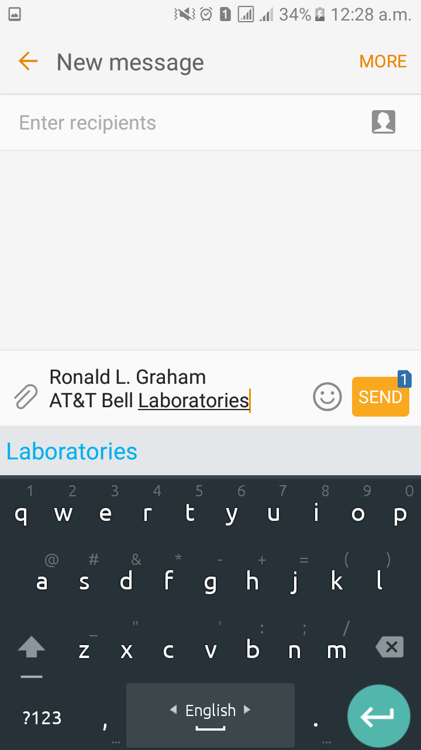
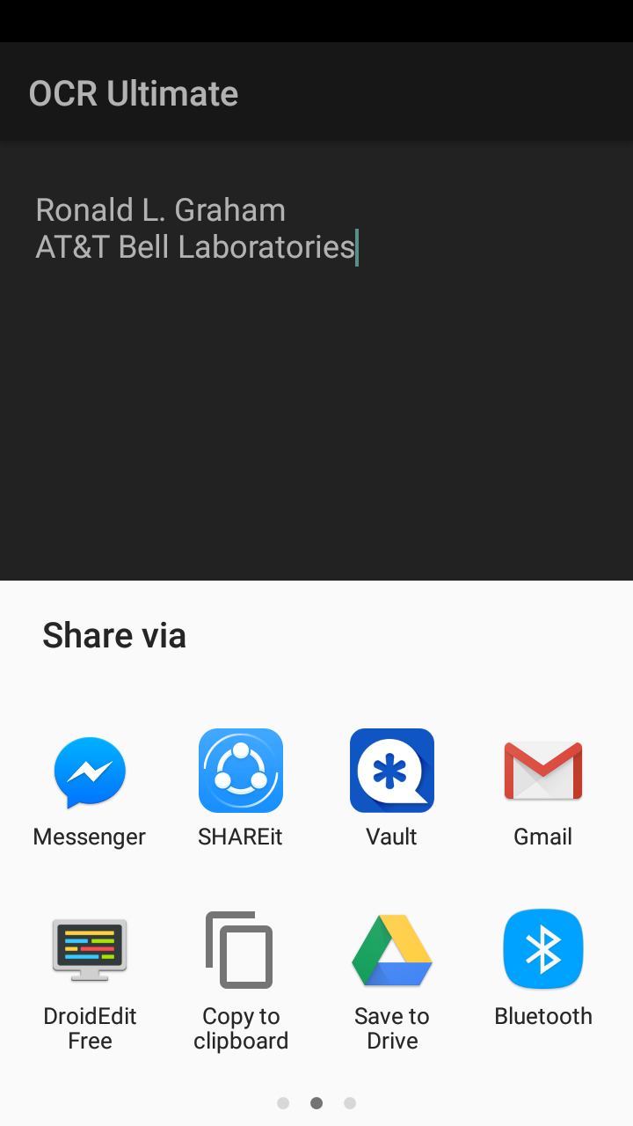
The result auto goes to clipboard when tapped on any block

Slide 21
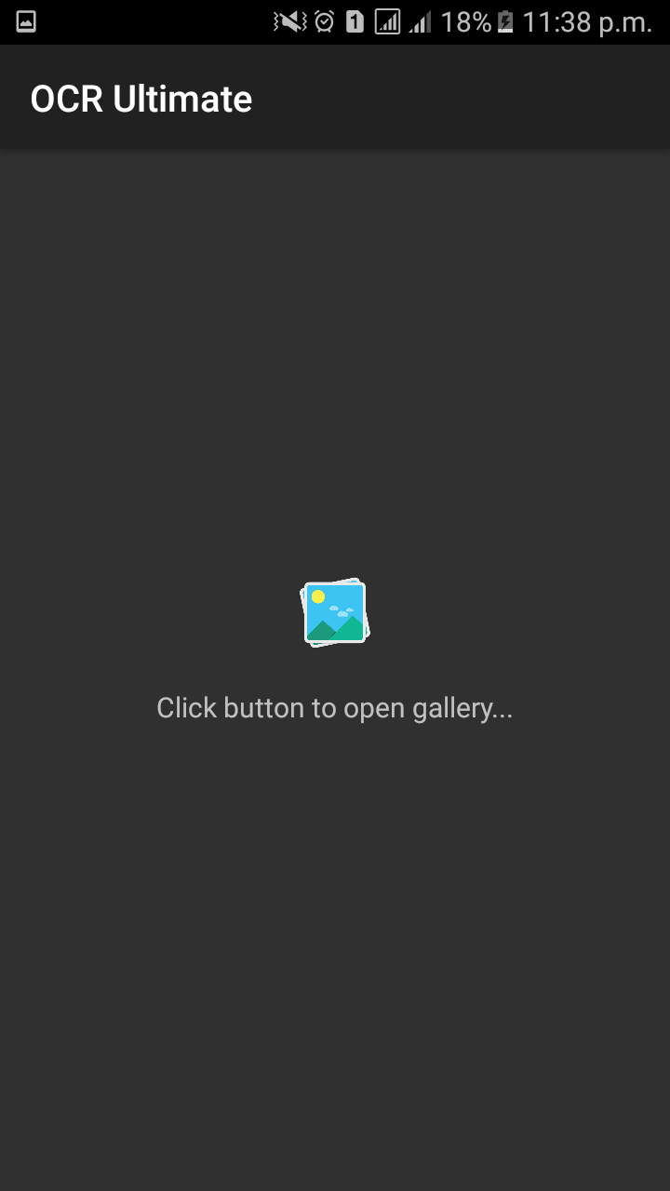
On clicking “Detect From Gallery” button

Slide 22
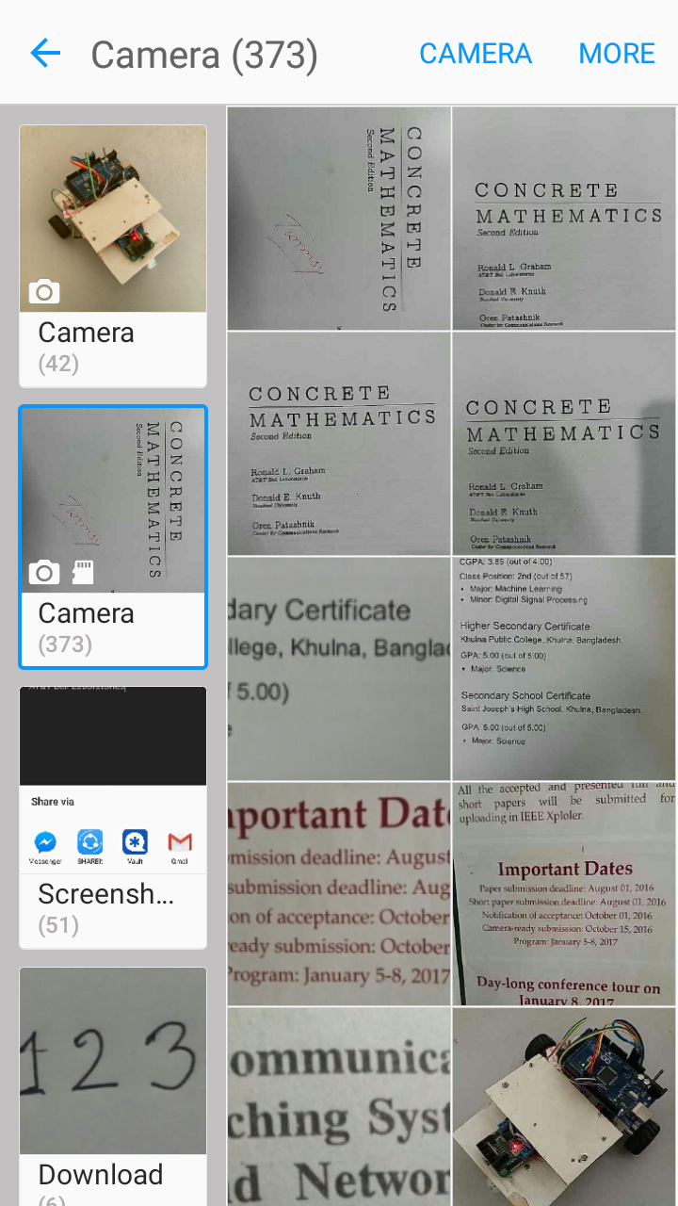
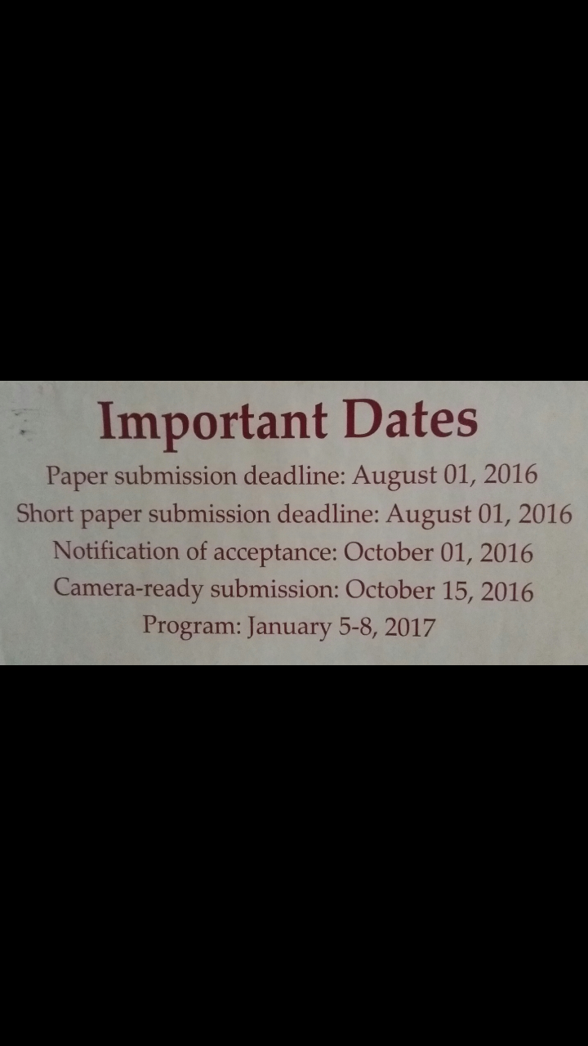
Select image from the gallery

Slide 23
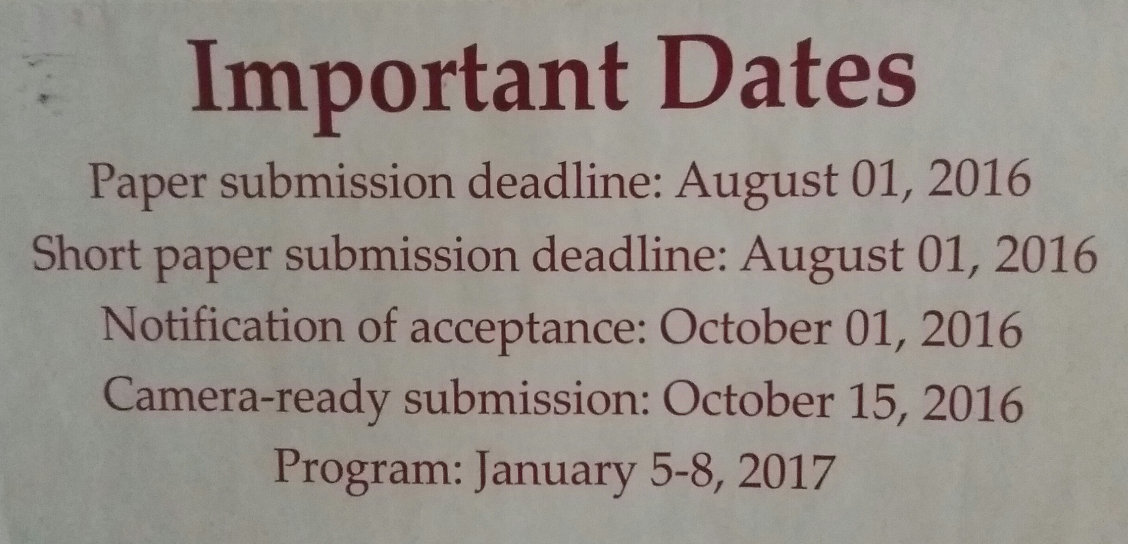
Selected image

Slide 24
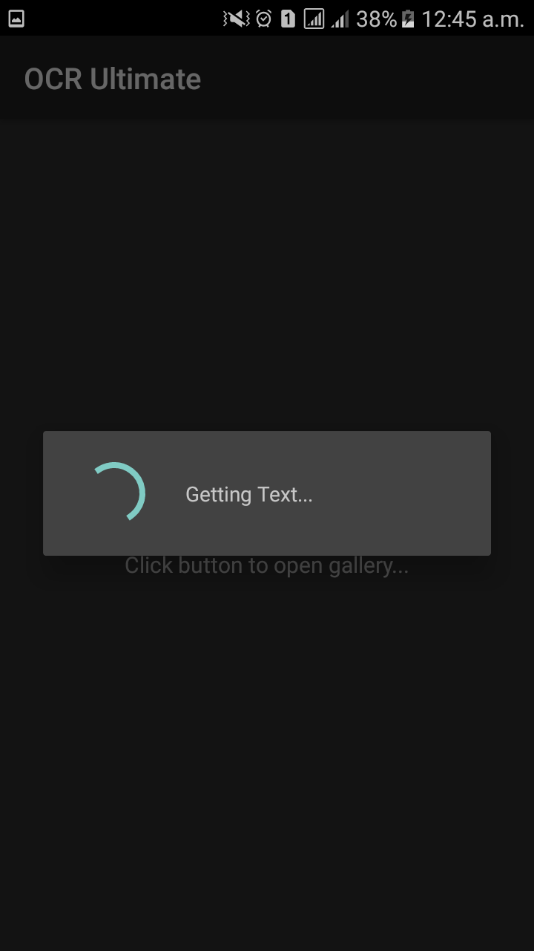
Analyzing and processing the image

Slide 25
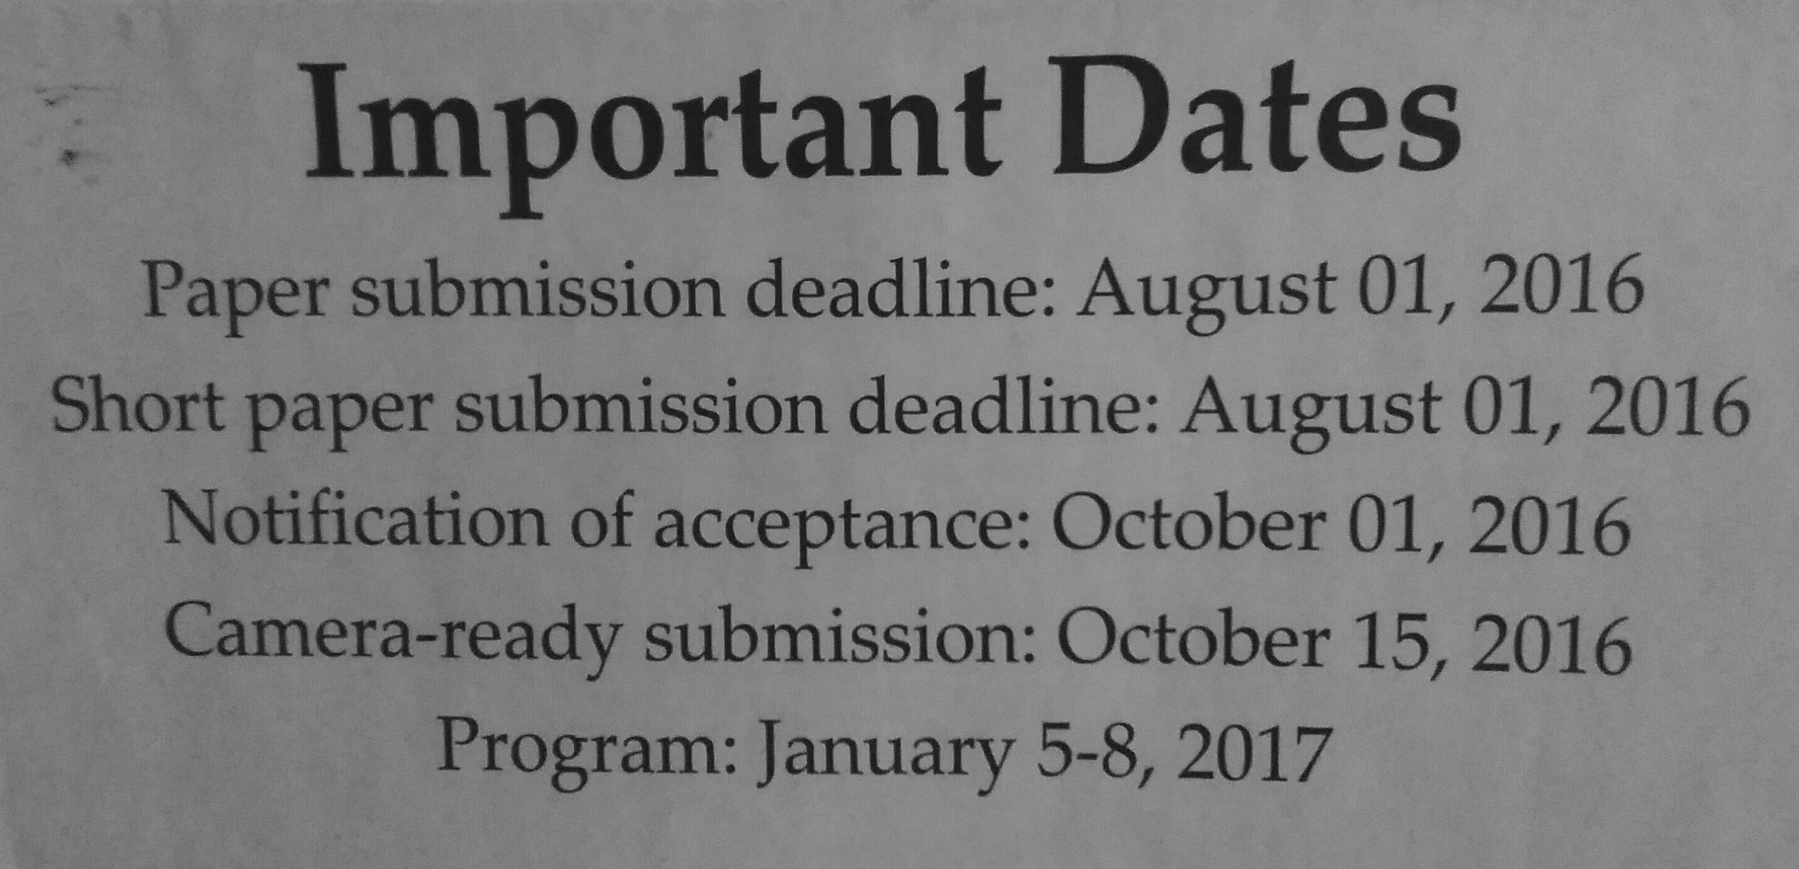
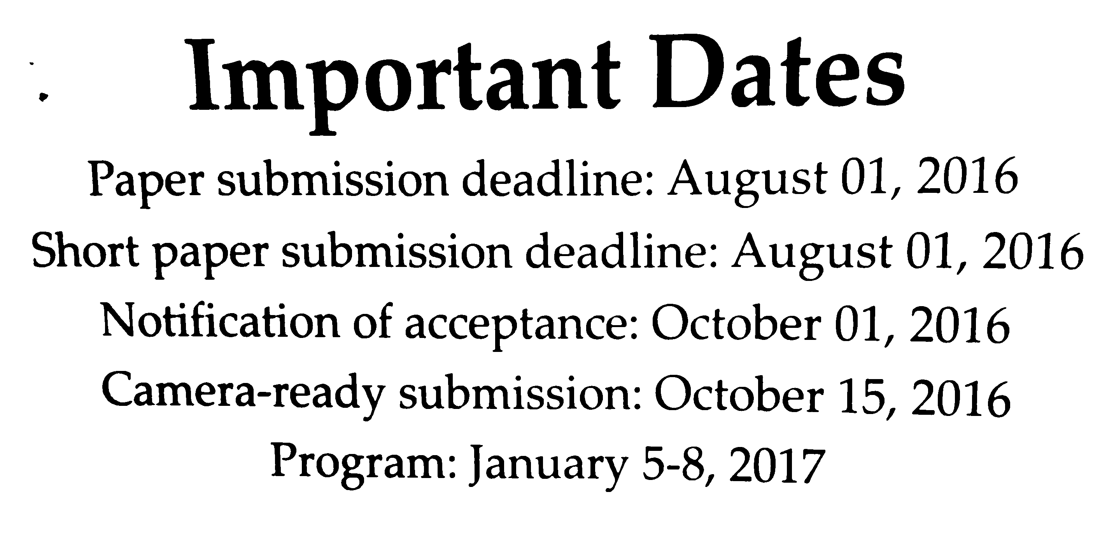

Image processing steps
Converted to Greyscale
Original Image
Final Image after applying Threshold
Applied Gaussian blur to reduce noise

Slide 26
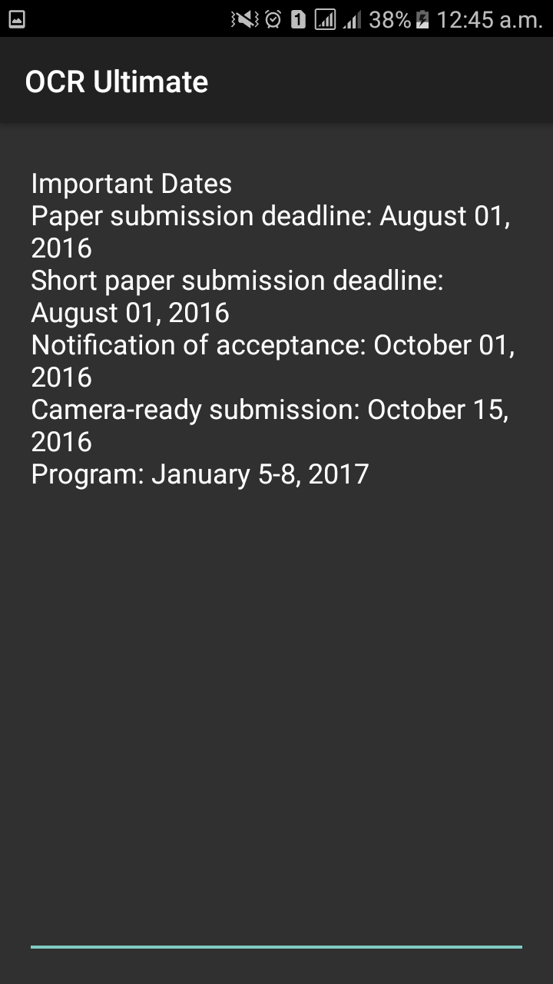
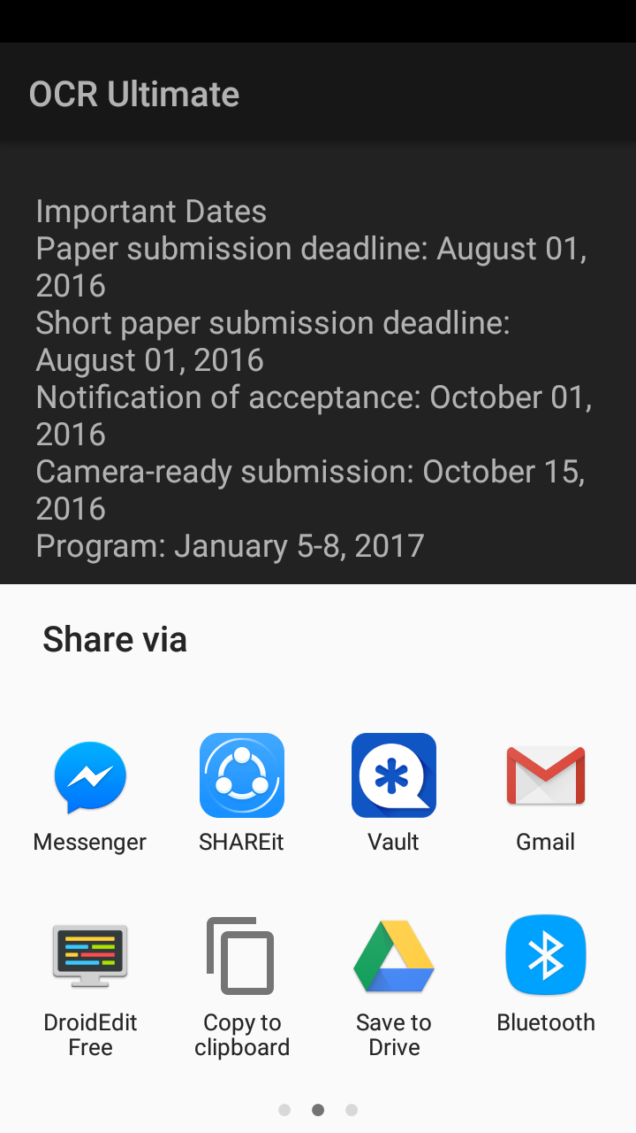
The final result auto goes to the clipboard from where copy/edit can be done

Slide 27
Application
When we need to call or save any mobile number or other information from a visiting card or bikash number from a printed copy in the shop or any mobile number printed or hand-written anywhere, to our phone, then we have to type the whole number in the dial pad by repeatedly seeing it from the source. It normally takes at least 8 second before calling or saving. But using our “Detect Text instantly” option, which acts real time, one can just hold the app to the document and by just one click, the whole number will be extracted in the screen. So this process is less disturbing and less time consuming than repeatedly seeing a number and type it.
Again, there are situations one student anyhow missed one or two lectures and so he/she want to collect that from his/her friend. But we all feel comfortable in reading printed copy than handwritten copy of others. In this case our app is here to the rescue by scanning an image, extracting all the text in a document which you can further edit or copy.
When you need a copy of even some printed document which is messy, but you can’t represent to others as this, then printing that document by a printer even doesn’t help. Then you are gonna need this app for clean text which now you can print.

Slide 28
Limitations
Unable to detect Bengali language.
Sometimes Google Tesseract’s performance is very poor.
Can select any one block at a time when detecting text instantly.
Doesn’t work for blur images.

Slide 29
Future plan about our Project
We will make sure that this app can detect Bengali in future. Currently we are working on this.
We are trying to increase the accuracy of detecting text more.
We are trying our best for releasing this app to Google Playstore.

Slide 30
Thank You

